Slide 1


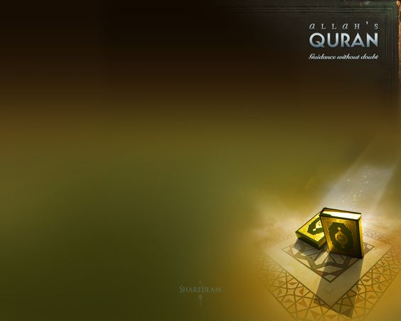



Slide 2
Introduction
to Sunnah
Hadith and its Compilation
(Sayings of Prophet Muhammad صلى الله عليه وسلم)

Slide 3
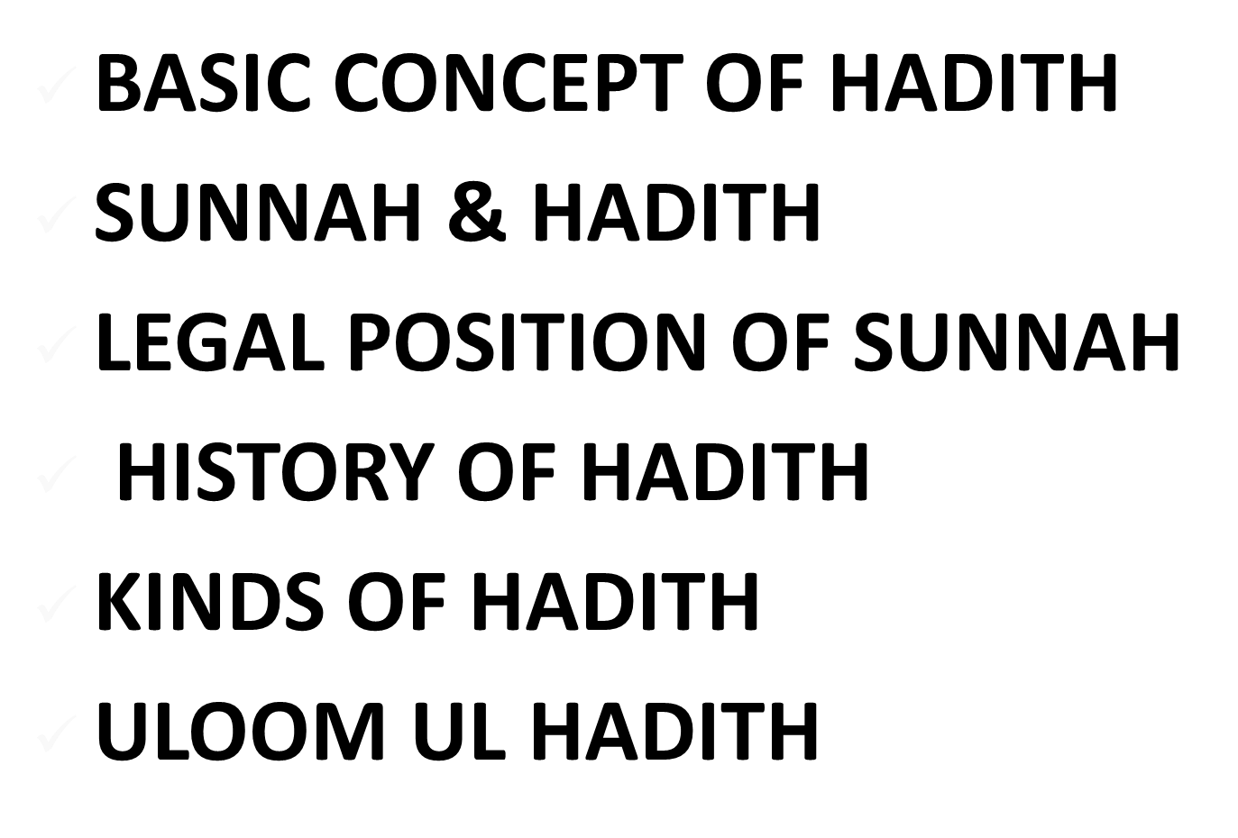
Outline of the Lesson

Slide 4
QUIZ-2
Putt major five prohibition actions by Surat al-Anaam

Slide 5


Slide 6
What is definition of Hadith?
Literally:
Arabic meaning ofحديث is Modern or Contemporary. Opposite of قديمAncient.
The word “Hadith” is derived from “Hadatha حد ثَ” which means to inform
It also means Conversation, News or Talking
As Term:
In Islamic literature it means the sayings of prophet Muhammad (صلى الله عليه وسلم), his actions and approval of the actions of others by him.

Slide 7
What is the definition of Hadith? Continue….
Nevertheless, the term Hadith has been used in Qur’an as well. There are 3 categories are the most notable usages in Holy Qur’an. It has been used to mean:
The Qur’an itself, and hadith. . Al-Qalam 44: [..فَذَرْنِي وَمَن يُكَذِّبُ بِهَـٰذَا الْحَدِيثِ ۖ] -- “Then leave Me alone [O’Muhammad] with those who reject this communication:”
A historical story. . Thaaha 9:
[ وَهَلْ أَتَاكَ حَدِيثُ مُوسَى] -- “ Has the story of Moses reached you”
A general Conversation. . At-Tahriim 3: […وَإِذْ أَسَرَّ النَّبِيُّ إِلَىٰ بَعْضِ أَزْوَاجِهِ حَدِيثً] -- “ When the Prophet confided in one of his wives….”

Slide 8
SUNNAH & HADITH

Slide 9
Quran and Hadith Qudsi
1) Quran is accurately word of Allah to Prophet (صلى الله عليه وسلم) through Angel Jibraeel. Quran starts with Surah Fatihah and ends with Surah Naas. Quran was written at the time of prophet Muhammad (صلى الله عليه وسلم). As it was revealed it was dictated. It was verified in house of Hafsa (رضي الله عنها) and compiled in the form of book at the time of Abu Bakar (رضي الله عنه). Quran is protected from any distortion by Almighty Allah himself.
2) Hadith Qudsi is the word of God revealed to Prophet (صلى الله عليه وسلم) through the language of Prophet. Qudsi does not necessarily mean it is confirmed or authentic. It can also be fake, or it’s Isnaad are questionable.

Slide 10
Sunnah and Hadith
Hadith and Sunnah are generally taken as synonymous terms but there are differences.
1) HADITH
Hadith implies the narration of a saying, or of an act, or of an approval (Tasweeb) of the Prophet (sws), irrespective of whether the matter is authenticated or still disputed. The Muhadditheen (the scholars of Hadith) use the word Taqreer to express Tasweeb. It implies that while doing something in the presence of the Prophet (sws), a Muslim acted in a particular manner and the Prophet (sws) observed it and did not disapprove it. So Hadith is overall traditional and scientific term of knowledge.

Slide 11
Sunnah and Hadith
2) SUNNAH
Literally, the word `Sunnah' means `a clear path', `busy path', `trodden path', `beaten path', `smooth path', etc. The manner in which the Almighty deals with nations---and which holds true for all nations---has been termed in the Holy Quran as the Sunnah of Allah. For instance:
"It was the practice [approved] of God amongst those of old that have passed away. And the Command of God is a decree determined." (33:38)
In the discussion which follows, we are going to discuss the Sunnah of the Prophet (sws). This means the way of life which the Prophet (sws) taught the people in theory and practice and for which, in his capacity as a teacher of Shariah (Islamic Law), he laid down ideal standards of leading a life which one should meet to earn Allah's approval through complete submission to His Commandments.

Slide 12
LEGAL POSITION OF SUNNAH

Slide 13
Legal position of
sunnah
Primary source of Islamic law after Quran
Used together with Quran in derivation of Islamic law
Explains matters in which Quran remained silent or a detailed description was not given
e.g. Performance of salah , Rate of Zakat
Non recited but Revelation
Commands by Allah Almighty

Slide 14
HISTORY OF HADITH

Slide 15
History of Hadith in the time of Prophet (صلى الله عليه وسلم)-1
1) Interestingly we have a documented Hadith that states that Prophet (صلى الله عليه وسلم) said not to write Hadith which is in the most reliable sources of Hadith.
The Prophet said, "Do not write down anything from me except the Quran." [Ahmed, Vol. 1, Page 171, and Sahih Muslim]
Ibn Saeed Al-Khudry reported that the Messenger of God (صلى الله عليه وسلم) had said:
The Prophet said, "Do not write anything from me EXCEPT QURAN. Anyone who wrote anything other than the Quran shall erase it."

Slide 16
History of Hadith in the time of Prophet (صلى الله عليه وسلم)-2
The speculated reasons are:
1. High rate of illiteracy. People were illiterate at the time and writing loses its value.
2. To prevent any diversion from the Qur’an or any mix up with the gradually flowing revelation and not have two texts to follow. There was no standard at the time to write Context of the Hadith.
3. Except in the case for Abdullah amr Ibn As & Ali bin Abi Thalib. These two people are allowed to write hadith by the Prophet because the Prophet knows that these two people will not get the sayings of the Prophet SAW (personal statements) mixed up with the Qur’anic Revelation.

Slide 17
History of Hadith in the time of Prophet (صلى الله عليه وسلم)-3
At first the Prophet (صلى الله عليه وسلم) stopped his companions (RadiAllahu Tala Anhum) from writing down hadiths, then afterwards this was permitted: Prophet of Allah (SallAllah-u-Alaihi-wa-Sallam) said to Abdullah bin Amr (RadiAllahu Tala Anho): Write hadiths, I swear by Him who holds my life in His hand, from this mouth nothing but the truth comes out. [Abu Dawood, volume 1, pg 158: Sanad is Sahih]
Abdullah bin Amr (رضي الله عنه) says: We were seated near prophet of Allah (صلى الله عليه وسلم) and were writing, in this manner was asked: He said: Hercule's city will be conquered first. [Darmi, p. 126: Sanad is Sahih]

Slide 18
History of Hadith in the time of Prophet (صلى الله عليه وسلم)-4
Prophet (صلى الله عليه وسلم) said: Write this hadith and give it to Abu shah (رضي الله عنه).... [Sahih Bukhari & Sahih Muslim] Ali (رضي الله عنه) says: We don't have anything but Kitab Allah and the scriptures in which are Hadiths of Prophet of Allah (SallAllah-u-Alaihi-wa-Sallam). [Sahih Bukhari & Sahih Muslim] Abu Huraira (رضي الله عنه) says: Amongst the Sahaba (رضي الله عنهم) no one narrates hadiths more than I do save Abdullah bin Amr (رضي الله عنه), because he used to write them and I didn't. [Sahih Bukhari] Anas (رضي الله عنه) heard a hadith and liked it so much, he told his son to write it and he wrote it. [Sahih Muslim, Kitab ul Iman]

Slide 19
History of Hadith in the time of Companions رضي الله عنهم-1
From the above few authentic narrations from many, we can conclude that Hadiths were being written down since the time of the prophet (SallAllah-u-Alaihi-wa-Sallam). Companions have recorded: The narrator Hamad bin Salma says: I got this book from Anas (رضي الله عنه)'s grandson Samama. [Nasai, kitab ul zakat] Imam Malik says: I read Omar (رضي الله عنه) 's book [Muwatta Malik, pg 106]
From such scripts other famous hadiths books were compiled.

Slide 20
Compilation of Hadith in the time of Companions رضي الله عنهم-2
When the Hadiths were copied and narrated into other books, it was but logical that the small compilations get engaged in bigger compilations.
It is not true that the Muhadditheen collected only verbally transmitted hadiths, and there were no compilations in the earlier times especially the first century of the hijra.
Old compilations can be found today like Sahifa Hammam, in which he took dictation from Abu Huraira (رضي الله عنه), this compilation is easily available for everyone to view.
There are Ahadiths which refer in last pages, to command Holy Prophet to writing down Hadith.

Slide 21
Compilation of Hadith in the time of Successors (تا بعين)
It was not until the Caliph Omar Ibn Abdelaziz year 99-101 Hijri year that he decided collecting and writing of hadith for the integrity of the teachings, and in the face of inaccuracies and outright forgery.
After the companions of Prophet (صلى الله عليه وسلم) there was a flow of recording of Hadith by Successors which lacked Organization and Verification.
Some 250 years after the fact, some efforts were made to separate the sayings of the Prophet (pbuh) from other sayings by the following scholars that are called Siha-e-Sittah (Six corrected books of Hadith):
- Al Boukhary died year 256H. – “Sahih Bukhari”
- Muslim ibn al-Hajjaj died year 261H. – “Sahih Muslim”
- Al-Tirmidhi died 279H. – “Jami al-Tirmidhi”
- Abu Dawood died year 275 H. – “Sunan Abu Dawood”
- Ibn Majah died year 273 H. – “Sunan Ibn Majah”
- Al Nisaie died year 303 H. – “Sunan al- Nisaie”

Slide 22
KINDS OF HADITH

Slide 23
kinds of Hadith as definition
Hadith can be divided into three categories; they are Qauli, Faili and Taqreeri.
1-Hadith Qauli: (حديث قولى)
is the kind of Hadith in which the sayings of the Prophet (p.b.u.h.) are mentioned.
2-Hadith faili:( حديث فعلى)
is that kind of Hadith in which the deeds and lifestyle of the Holy Prophet (p.b.u.h.) is mentioned.
3-Hadith taqreeri:( حديث تقريرى)
is the kind of Hadith in which the silence of the Holy Prophet (p.b.u.h.) is mentioned when his companion did something or said something in his presence.

Slide 24
ULOOM UL HADITH

Slide 25
ULOOM UL HADITH
Uloom ul Hadith means the knowledge and science in which we get information about sanad and matan.
What is Sana and Matan?

Slide 26
HADITH
MATN
(Body of
the Text)
SANAD
(Chain of
Narrations)
MARFOO’
OR
MUSNAD
(Elevated up
to the Prophet)
MAWQOOF
(Stopped at the
Companions)
MAQTOO’
OR
MURSAL
(Stopped at the
Successors)

Slide 27
SANAD (Chain)
Each hadith consists of two parts, sanad (chain of transmission) and matan (text), Said Who, To Who and who knows that he said it to the other person (Witness) and who said that these were witness (2nd Witness).
Qutaybah Ibn Sa‘eed informed us that: Sufyan reported to us on the authority of Zuhri, on the authority of Humayd... on the authority of Nu‘man Ibn Bashir, that his father bestowed him a slave; thereupon he came to the Prophet (SAW) so as to make him a witness upon it. He (the Prophet ) asked: Have you bestowed (a slave each) to all of your children; he (Bashir) replied no. So he (the Prophet) asked (Bashir): take him (the slave) back.
The first part of this hadith , from ‘‘Qutaybah Ibn Sa‘eed informed us’’ to ‘‘Nu‘man Ibn Bashir’’ is sanad (pl. Isnad) and the second part, from ‘‘that his father’’ to ‘‘take him (the slave) back.’’ is matan.

Slide 28
MATAN (Text)
Matan (Text) means the saying of the Propthet (صلى الله عليه وسلم) after last witness who narrated that wording.
We should be able to critique MATAN as well because we should know that the text is leading to something good or not.
Imam Al Ghazali stated that a hadith could be rejected if the matn contradicts Qur’an or more authentic hadith.
Imam Al Soyouti 1445-1505: “If you encounter a hadith contrary to reason or to an established correctly accepted principle, you should know that it is fake”.

Slide 29
EXAMPL OF SANA & MATAN
حَدَّثَنَا مُسَدَّدٌ، قَالَ: حَدَّثَنَا يَحْيَى، عَنْ شُعْبَةَ، عَنْ قَتَادَةَ، عَنْ أَنَسٍ عَنِ النَّبِيِّ صَلَّى اللهُ عَلَيْهِ وَسَلَّمَ قَالَ: «لاَ يُؤْمِنُ أَحَدُكُمْ، حَتَّى يُحِبَّ لِأَخِيهِ مَا يُحِبُّ لِنَفْسِهِ»
Musadad told us that Yahyaa informed him from Shubah, from Qadatah, from Anas from the Prophet (Peace Be Upon Him)
“ None of you truly becomes a believer until he loves for his brother what he loves for himself ” {Bukhari}

Slide 30
Precautions taken
in the compilation of ahadith
Sanad (chain of narrators)
Must be un-interrupt
Must not be broken
Must go back to Holy Prophet(ﷺ)
Narrators should have actually met each other
Narrators must not be liars
Narrators should have sharp memory
Narrators must be pious and possess good character

Slide 31
Precautions taken
in the compilation of ahadith
Matan (text)
Must be in a pure arabic style
Must not be in contradiction to historical facts and common sense
Must not be against Islam , Quran or any other authentic hadith
Must not abuse the family of Holy Prophet(s.a.w)

Slide 32
Ranking of Hadith
Saheeh. Sound, which means that according to the criteria set by the specific compiler
Hasan the chain is fair, good enough, but not perfect.
Dhaeif weak, because members of the chain are unreliable.
Maudu forgery.

Slide 33
KINDS OF ULOOM UL HADITH

Slide 34
KINDS
Ilm-i-riwaiat-ul-Hadith. (علم رواية الحديث)
It is the science of Hadith in which the knowledge about the text of Hadith is given.
Ilm-i-diraiat-ul-Hadith:(علم دراية الحديث)
It is the science of Hadith in which the knowledge about the narrators of Hadith is given. This science is also known as “Fann-ul-rijal” i.e. the science of narrators.

Slide 35


